Slide 1

TherapyPal Improving mental health, one session at a time.

Slide 2
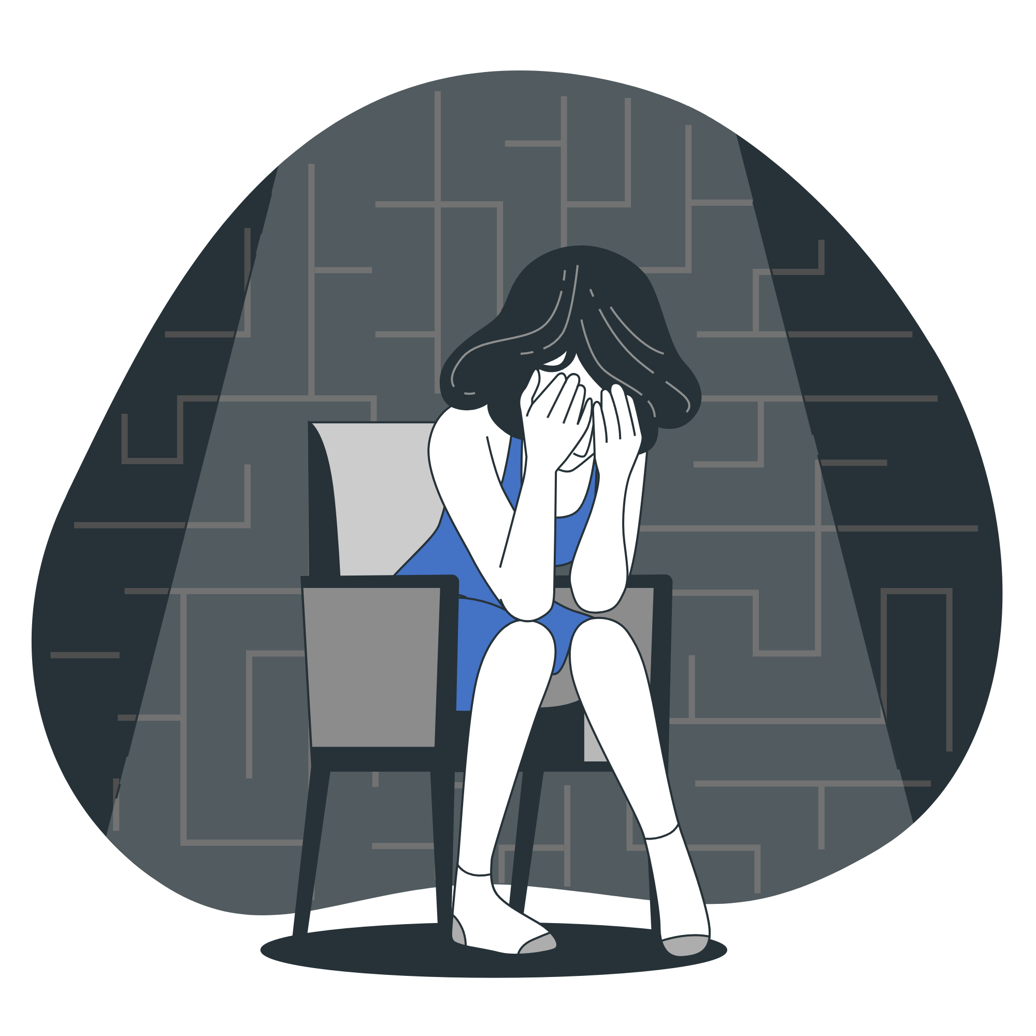
Prevalence of Mental Health Conditions: OCD, ADHD/AD, and Postpartum Depression
These mental health conditions affect millions of people worldwide. Patients often struggle to find appropriate treatment or access to care, leading to a lack of progress in their recovery journey.

Slide 3
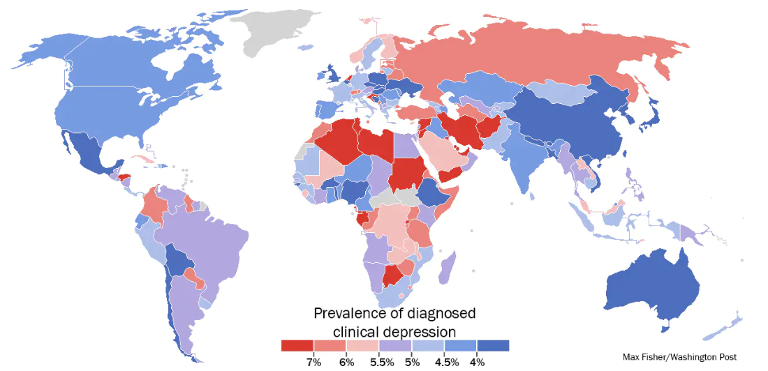
A stunning map of depression rates around the world
our office

Slide 4

Our process is easy
Take Quiz
Get Analysis
Get treatment
With TherapyPal, the first step is to take our depression quiz. This quiz is designed to help you identify symptoms of depression and assess your overall mental health.
Once you've taken the quiz, our team of experienced therapists will analyze your answers and develop a personalized treatment plan just for you
Once your quiz answers are analyzed, we'll connect you with a licensed therapist who specializes in your specific mental health needs.

Slide 5

Stepping Forward
The journey towards healing from depression starts with a single step.

Slide 6
Roadmap
User takes the quiz on TherapyPal mobile application.
Therapist logs into the TherapyPal website
Therapist contacts the patients and start the treatment Process
1
3
5
2
4
The Answers are sent to the ML model for evaluation.
Therapist enter the user details and retrieves the answers.

Slide 7

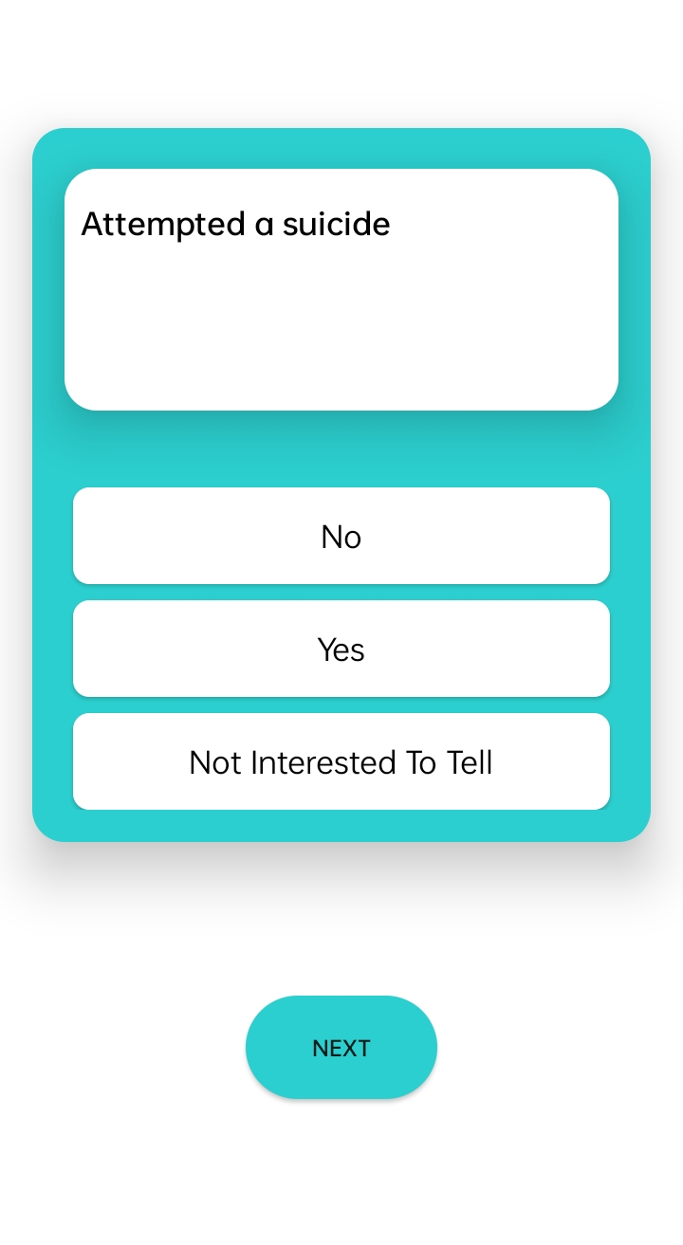
Mobile project
Take control of your mental health on the go with TherapyPal's mobile app. Access therapy quizzes, get results and get the support you need, whenever and wherever you need it."

Slide 8
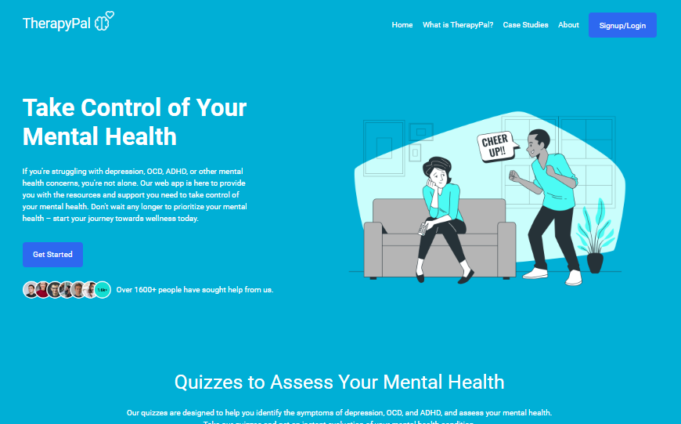
Desktop project
Our easy-to-use therapyPal desktop application allows you to connect with licensed therapists and get the support you need to improve your mental health."

Slide 9

Remember that depression is a treatable illness. With the right therapy, medication, and support, you can overcome this challenge
and live a happy and
healthy life.

Slide 10




Team Presentation
Vaani Pathariya Web and ML Developer
Anubhav Pal Web Developer
Devanshi Bahuguna Web Developer
Shagun Chahar Android Developer

Slide 11
Thanks!
Feel free to ask any question?

